Slide 1

Physics (PHY 102)Thermodynamics
Farjana Yeasmin
Lecturer in Physics, Basic Science Division
World University of Bangladesh

Slide 2


Objectives
Thermodynamics

Slide 3
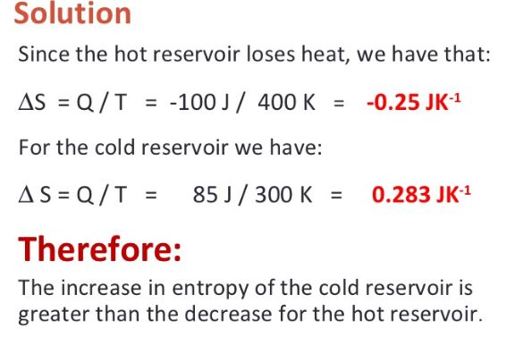
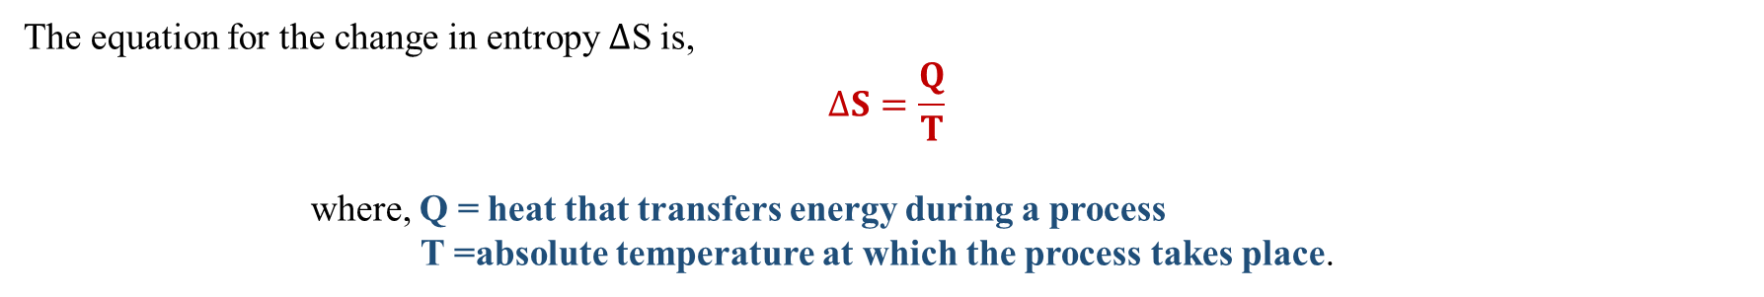
Entropy
The equation for the change in entropy ΔS is,
$$∆S=\frac{Q}{T}$$
where, Q = heat that transfers energy during a process
T =absolute temperature at which the process takes place.
Solution:
Example:
A heat engine removes 100 J each cycle from a heat reservoir at 400 K and exhausts 85 J of thermal energy to a reservoir at 300 K. Compute the change in entropy for each reservoir.
Therefore, the increase in entropy of the cold reservoir is greater than the decrease for the hot reservoir.

Slide 4
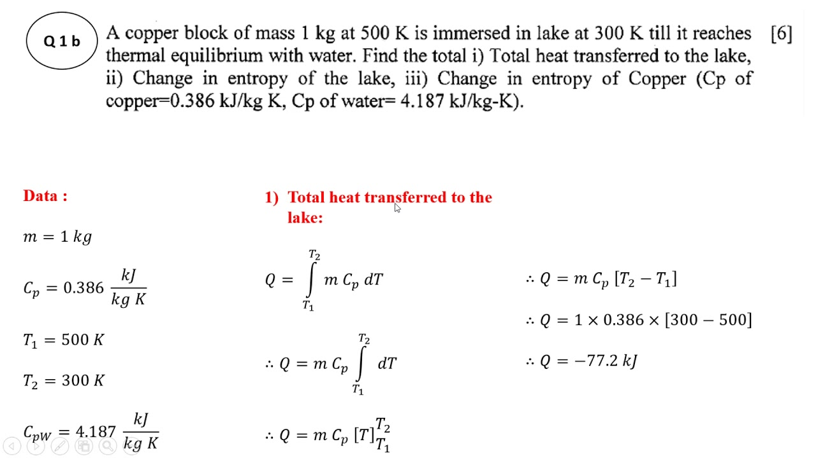
Entropy-Mathematical problem

Slide 5
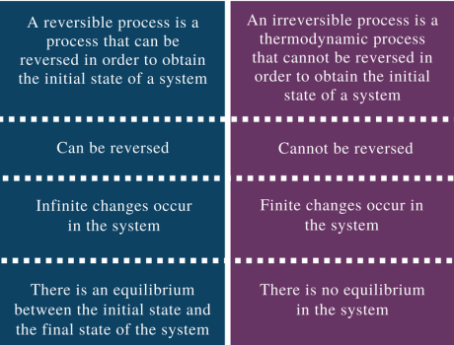
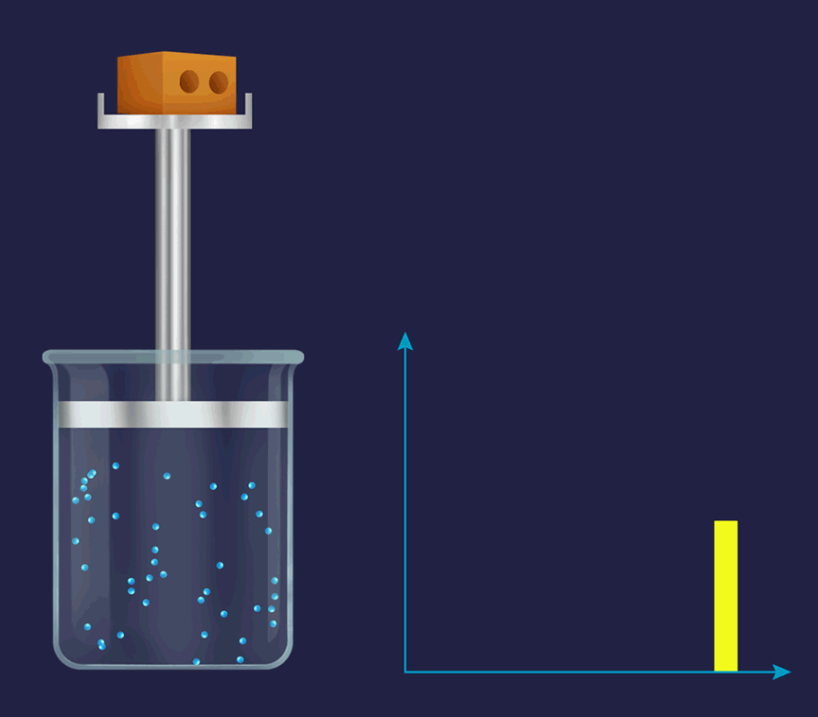
Reversible Process vs Irreversible Process

Slide 6
Heat Engine
A heat engine is a type of engine, (like the motor in a car) that produces macroscopic motion from heat.
When people rub their hands together friction turns mechanical energy (the motion of our hands) into thermal energy (the hands get warmer). Heat engines do just the opposite; they take the energy from being warm (compared to the surroundings) and turn that into motion. Often this motion is turned into electricity with a generator.
Example: Gasoline and diesel engines, jet engines, and steam turbines that generate electricity

Slide 7

Carnot Engine
The Carnot engine is a theoretical thermodynamic cycle proposed by Leonard Carnot. It estimates the maximum possible efficiency that a heat engine during the conversion process of heat into work and, conversely, working between two reservoirs can possess.
A Carnot cycle is defined as an ideal reversible closed thermodynamic cycle.
Four successive operations are involved: isothermal expansion, adiabatic expansion, isothermal compression, and adiabatic compression.

Slide 8
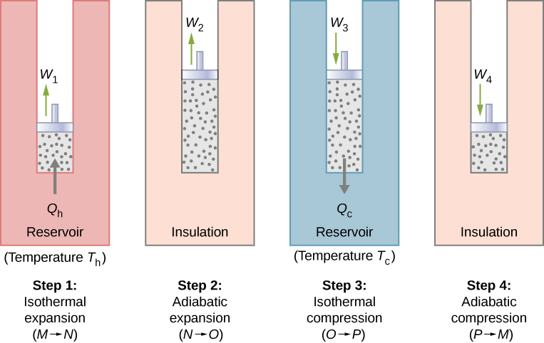
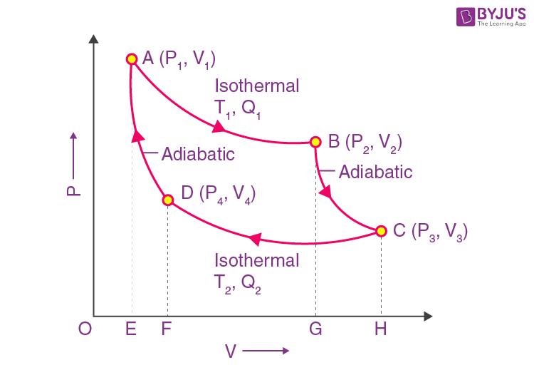
Carnot Cycle
The Carnot cycle consists of the following four processes:
A reversible isothermal gas expansion process. In this process, the ideal gas in the system absorbs q_{in} amount heat from a heat source at a high temperature T_{high}, expands and does work on surroundings.
A reversible adiabatic gas expansion process. In this process, the system is thermally insulated. The gas continues to expand and do work on surroundings, which causes the system to cool to a lower temperature, T_{low}
A reversible isothermal gas compression process. In this process, surroundings do work to the gas at T_{low} and causes a loss of heat, q_{out}
A reversible adiabatic gas compression process. In this process, the system is thermally insulated. Surroundings continue to do work to the gas, which causes the temperature to rise back to T_{high}

Slide 9
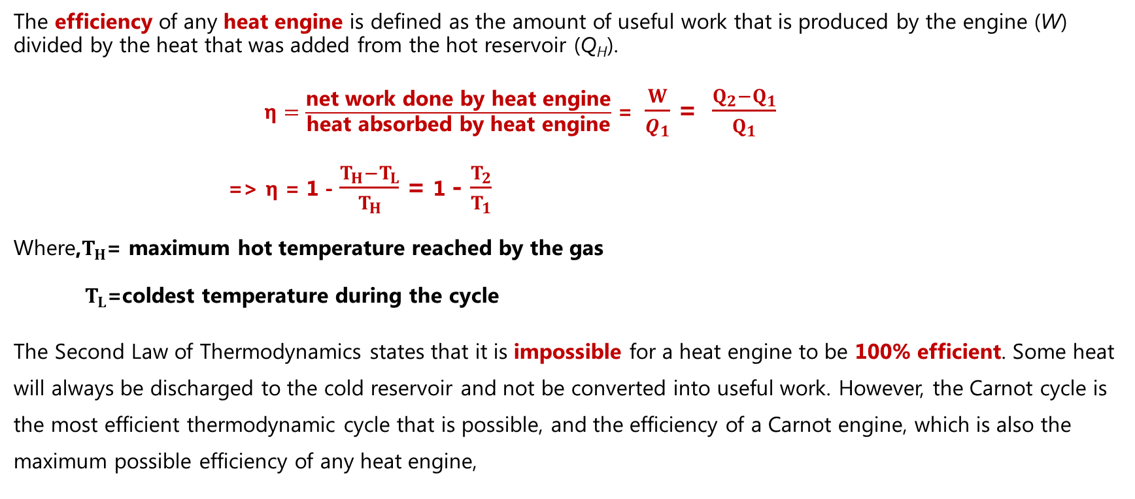
Efficiency of Carnot Engine
The efficiency of any heat engine is defined as the amount of useful work that is produced by the engine (W) divided by the heat that was added from the hot reservoir (Q_{H}).
$η=\frac{\text{net} \text{work} \text{done} \text{by} \text{heat} \text{engine}}{\text{heat} \text{absorbed} \text{by} \text{heat} \text{engine}}$ = $\frac{W}{Q_{1}}$ = $\frac{Q_{2}−Q_{1}}{Q_{1}}$
=> $η$ = 1 - $\frac{T_{H}−T_{L}}{T_{H}}$ = 1 - $\frac{T_{2}}{T_{1}}$
Where,$T_{H}$= maximum hot temperature reached by the gas
$T_{L}$=coldest temperature during the cycle
The Second Law of Thermodynamics states that it is impossible for a heat engine to be 100% efficient. Some heat will always be discharged to the cold reservoir and not be converted into useful work. However, the Carnot cycle is the most efficient thermodynamic cycle that is possible, and the efficiency of a Carnot engine, which is also the maximum possible efficiency of any heat engine,

Slide 10
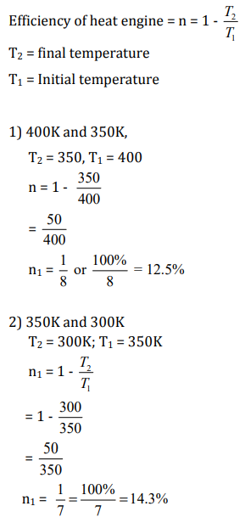
Mathematical Problem
Calculate difference in efficiency of a Carnot energy working between:-
1) 400K and 350K
2) 350K and 300K
Solution:

Slide 11
Conclusions
Thank you

